Slide 1
Introduction to Wireless Networking
Dimitrios Koutsonikolas
09/06/2017
These slides contain material developed by Lili Qiu for CS386W at UT Austin and by J.F Kurose and K.W. Ross

Slide 2
Internet Protocol Stack
Application: supporting network applications
  FTP, SMTP, HTTP
Transport: data transfer between processes
  TCP, UDP
Network: routing of datagrams from source to destination
  IP, routing protocols
Link: data transfer between neighboring network elements
  Ethernet, WiFi
Physical: bits “on the wire”
  Coaxial cable, optical fibers, radios
application
transport
network
link
physical

Slide 3
Multiple Access
Protocols
application
transport
network
link
physical

Slide 4
Multiple Access protocols
single shared broadcast channel
two or more simultaneous transmissions by nodes: interference
  collision if node receives two or more signals at the same time
multiple access protocol
distributed algorithm that determines how nodes share channel, i.e., determine when node can transmit

Slide 5
Ideal Multiple Access Protocol
Broadcast channel of rate R bps
1. when one node wants to transmit, it can send at rate R.
2. when M nodes want to transmit, each can send at average rate R/M
3. fully decentralized:
  no special node to coordinate transmissions
  no synchronization of clocks, slots
4. simple

Slide 6
MAC Protocols: a taxonomy
Three broad classes:
Channel Partitioning
  divide channel into smaller “pieces” (time slots, frequency, code)
  allocate piece to node for exclusive use
Random Access
  channel not divided, allow collisions
  “recover” from collisions
“Taking turns”
  nodes take turns, but nodes with more to send can take longer turns

Slide 7
Channel Partitioning MAC protocols: TDMA
TDMA: time division multiple access
access to channel in "rounds"
each station gets fixed length slot (length = pkt trans time) in each round
unused slots go idle
example: 6-station LAN, 1,3,4 have pkt, slots 2,5,6 idle
6-slot
frame
1
3
4
1
3
4

Slide 8
Channel Partitioning MAC protocols: FDMA
FDMA: frequency division multiple access
channel spectrum divided into frequency bands
each station assigned fixed frequency band
unused transmission time in frequency bands go idle
example: 6-station LAN, 1,3,4 have pkt, frequency bands 2,5,6 idle
time
frequency bands
FDM cable
Notes:
C = B*log_2(1+SNR)

Slide 9
Random Access Protocols
When node has packet to send
  transmit at full channel data rate.
Two or more transmitting nodes ➜ “collision”,
Random access MAC protocol specifies:
  how to detect collisions
  how to prevent collisions
  how to recover from collisions (e.g., via delayed retransmissions)
Examples of random access MAC protocols:
  slotted ALOHA
  ALOHA
  CSMA, CSMA/CD, CSMA/CA

Slide 10
CSMA (Carrier Sense Multiple Access)
CSMA: listen before transmit:
If channel sensed idle: transmit entire frame
If channel sensed busy, defer transmission
human analogy: don’t interrupt others!

Slide 11

CSMA collisions
spatial layout of nodes
collisions can still occur:
propagation delay means
two nodes may not hear
each other’s transmission
collision:
entire packet transmission
time wasted
note:
role of distance & propagation delay in determining collision probability

Slide 12
CSMA/CD (Collision Detection)
CSMA/CD: carrier sensing, deferral as in CSMA
  collisions detected within short time
  colliding transmissions aborted, reducing channel wastage
Collision detection:
  easy in wired LANs: measure signal strengths, compare transmitted, received signals
  difficult in wireless LANs: received signal strength overwhelmed by local transmission strength

Slide 13
PHY Layer
application
transport
network
link
physical

Slide 14
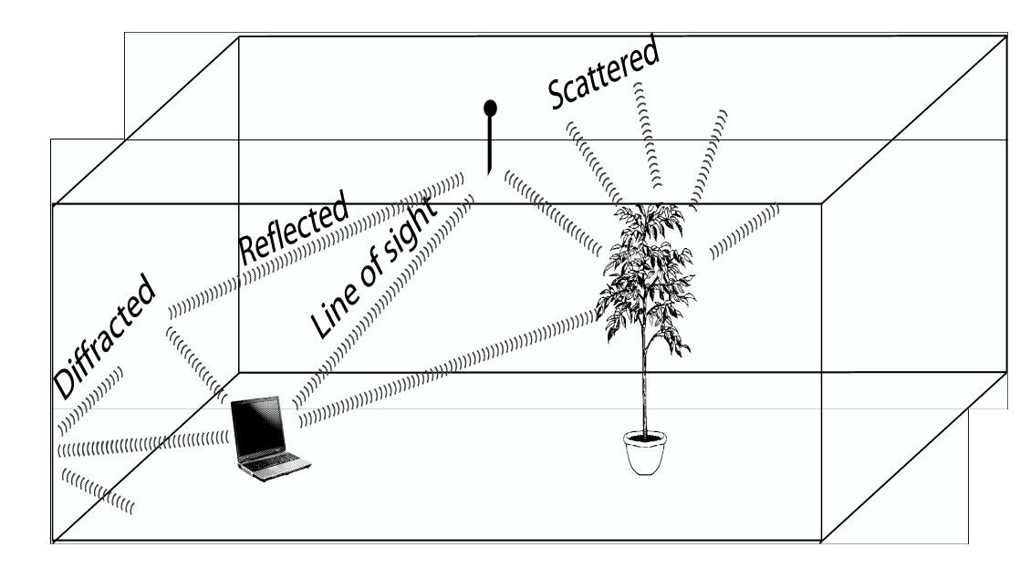
Wireless Link Characteristics
Wireless is a broadcast medium!
Differences from wired link ….
  decreased signal strength: radio signal attenuates as it propagates through matter (path loss)
  interference from other sources: standardized wireless network frequencies (e.g., 2.4 GHz) shared by other devices (e.g., phone); devices (motors, microwaves) interfere as well
  multipath propagation (fading): radio signal reflects off objects or ground, arriving at destination at slightly different times
    Reflection
    Diffraction
    Scattering
Signal Strength
space

Slide 15
Impact of Multipath Propagation
Direct signal
Reflected signal
Received signal

Slide 16
Wireless Link Characteristics (2) – Fading
Channel characteristics change over time and location
  e.g., movement of sender, receiver and/or scatters
➔ quick changes in the power received (short term/fast fading)
➔ slow changes in the average power
received (long term/slow fading)
long term
fading
power
t
short term fading
Notes:
Fast fading: usually observed over distances of about half a wavelength. For VHF and UHF, a vehicle traveling at 30 miles per hour can pass through several fast fades in a second
Slow fading: movement over distances large enough to produce gross variations in the overall path

Slide 17
Typical Picture
Received
Signal
Power
(dBm)
path loss
slow fading
fast fading
log (distance)
20
Notes:
Pt = PrGtGr (λ/4pR)^2

Slide 18
Signal Propagation Ranges
Transmission range
  communication possible
  low error rate
Detection range
  detection of the signal
  possible
  no communication
  possible
Interference range
  signal may not be
  detected
  signal adds to the
  background noise
sender
transmission
distance
detection
interference
Notes:
These ranges are not circular in the real world.

Slide 19
Signal, Noise, and Interference
Signal (S)
Noise (N)
  Includes thermal noise and background radiation
Interference (I)
  Signals from other transmitting sources
SINR = S/(N+I) (sometimes also denoted as SNR)
Large SINR = easier to extract signal from noise

Slide 20
dB and Power conversion
dB
  Denote the difference between two power levels
  (P2/P1)[dB] = 10 * log10 (P2/P1)
  P2/P1 = 10^(A/10)
  Example 1: P2 = 10 P1, P2/P1=10dB
  Example 2: P2/P1 = 33dB, P2 = 2000 P1
dBm and dBW
  Denote the power level relative to 1 mW or 1 W
  P[dBm] = 10*log10(P/1mW)
  P[dBW] = 10*log10(P/1W)
  Example: P = 0.001mW = -30dBm, P = 100W = 20dBW
10dB: factor of 10
3dB: factor of 2

Slide 21
Wireless Link Characteristics (3)
SNR: signal-to-noise ratio
  larger SNR – easier to extract signal from noise
SNR versus BER tradeoffs
  given physical layer: increase power -> increase SNR->decrease BER
  given SNR: choose physical layer that meets BER requirement, giving highest throughput
10⁻¹
10⁻²
10⁻³
BER
10⁻⁴
10⁻⁵
10⁻⁶
10⁻⁷
10
20
30
40
SNR(dB)
QAM256 (8 Mbps)
QAM16 (4 Mbps)
BPSK (1 Mbps)

Slide 22
Rate Adaptation
base station, mobile dynamically change transmission rate (physical layer modulation technique) as mobile moves, SNR varies
10⁻¹
10⁻²
10⁻³
BER
10⁻⁴
10⁻⁵
10⁻⁶
10⁻⁷
10
20
30
40
SNR(dB)
1. SNR decreases, BER increase as node moves away from base station
QAM256 (8 Mbps)
QAM16 (4 Mbps)
BPSK (1 Mbps)
operating point
2. When BER becomes too high, switch to lower transmission rate but with lower BER

Slide 23


802.11 LAN architecture
wireless host communicates with base station
  base station = access point (AP)
Basic Service Set (BSS) (aka “cell”) in infrastructure mode contains:
  wireless hosts
  access point (AP): base station
  ad hoc mode: hosts only
Internet
hub, switch
or router
AP
BSS 1
AP
BSS 2
Notes:
SSID (name) vs BSSID (AP MAC address)

Slide 24
IEEE 802.11 Wireless LANs
802.11b
2.4-2.5 GHz unlicensed spectrum
up to 11 Mbps
802.11a
5-6 GHz range
up to 54 Mbps
802.11g
  2.4-2.5 GHz range
  up to 54 Mbps
802.11n: multiple antennae
  2.4-2.5 and 5-6 GHz range
  up to 600 Mbps
    MIMO
    Frame aggregation
    Channel bonding
802.11ac
  5-6 GHz range
  up to 3.4 Gbps
    MU-MIMO
all use CSMA/CA for multiple access

Slide 25
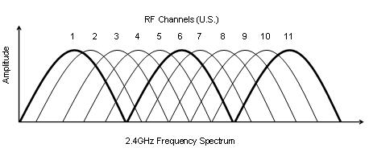
802.11: Channels
802.11b/g: 2.4GHz-2.485GHz spectrum divided into 11 channels at different frequencies
  AP admin chooses frequency for AP
  interference possible: channel can be same as that chosen by neighboring AP!
  802.11a: 8 non-overlapping channels
Only 3 non-overlapping channels!

Slide 26
802.11: Association
host must associate with an AP
  scans channels, listening for beacon frames containing AP’s name (SSID) and MAC address
  selects AP to associate with
  may perform authentication
  will typically run DHCP to get IP address in AP’s subnet

Slide 27
802.11: passive/active scanning
BBS 1
BBS 2
BBS 1
BBS 2
AP 1
AP 2
AP 1
1
AP 2
1
1
2
2
2
3
3
4
H1
H1
Passive Scanning:
beacon frames sent from APs
association Request frame sent: H1 to selected AP
association Response frame sent: H1 to selected AP
Active Scanning:
Probe Request frame broadcast from H1
Probes response frame sent from APs
Association Request frame sent: H1 to selected AP
Association Response frame sent: H1 to selected AP

Slide 28
IEEE 802.11 multiple access
802.11: CSMA - sense before transmitting
Differences from Ethernet
  No collision detection (CD)!
    Difficult to receive (sense collisions) when transmitting due to weak received signals (fading)
    Can’t sense all collisions in any case: hidden terminal, fading
    Goal: avoid collisions: CSMA/C(ollision)A(voidance)
  Link layer ACKnowledgments/Retransmissions (ARQ)
    High bit error rates
A
B
C
C
A’s signal
strength
C’s signal
strength
B
A
space

Slide 29
IEEE 802.11 MAC Protocol: CSMA/CA
802.11 sender
1 if sense channel idle for DIFS then
  transmit entire frame (no CD)
2 if sense channel busy then
2.1 start random backoff time
  timer counts down while channel idle, freezes when busy, resumes if idle for DIFS
  transmit when timer expires (why?)
3 if ACK, wait for DIFS, then go to 2.1 (why?)
4 if no ACK, increase random backoff interval, goto 2.1 (why?)
802.11 receiver
- if frame received OK
return ACK after SIFS (ACK needed due to hidden terminal problem)
sender
receiver
DIFS
data
SIFS
ACK
Notes:
Does it always avoid collisions? How to do rate adaptation?

Slide 30
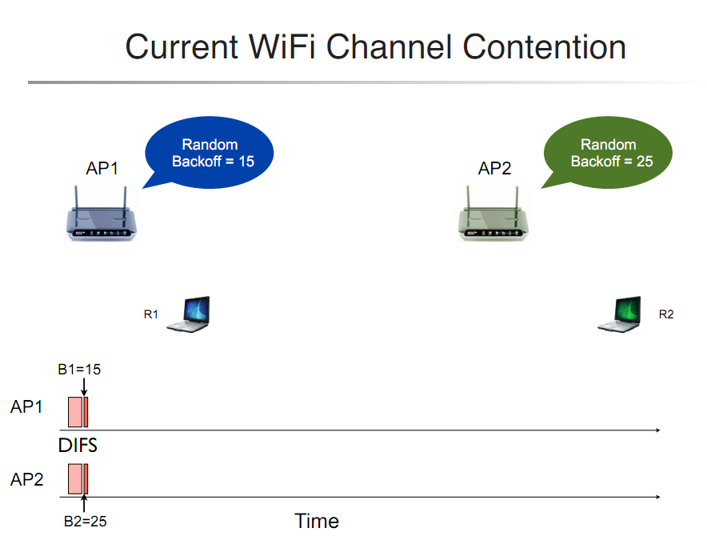
802.11 Backoff Example

Slide 31
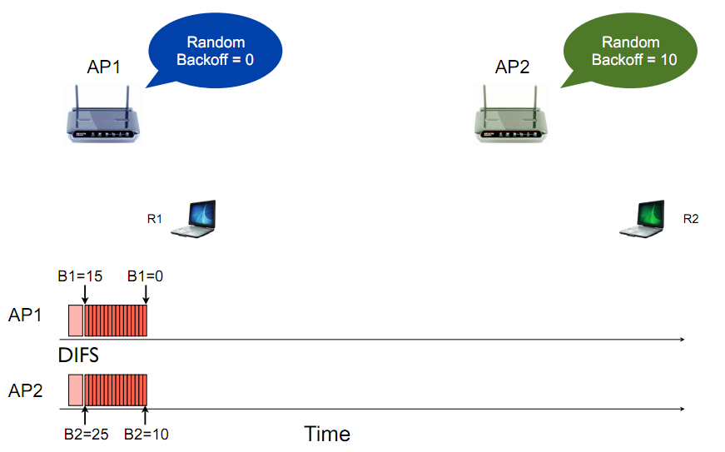
802.11 Backoff Example
After 15 slot countdown

Slide 32
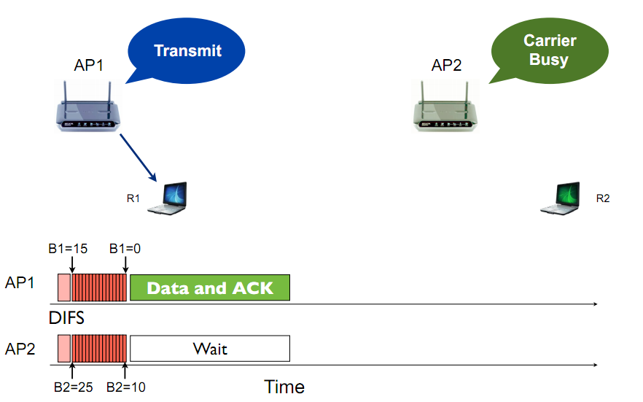
802.11 Backoff Example

Slide 33
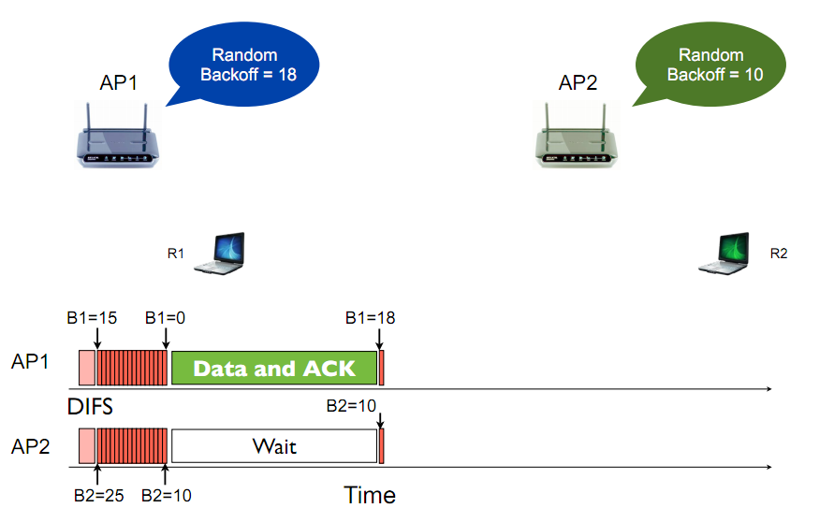
802.11 Backoff Example

Slide 34
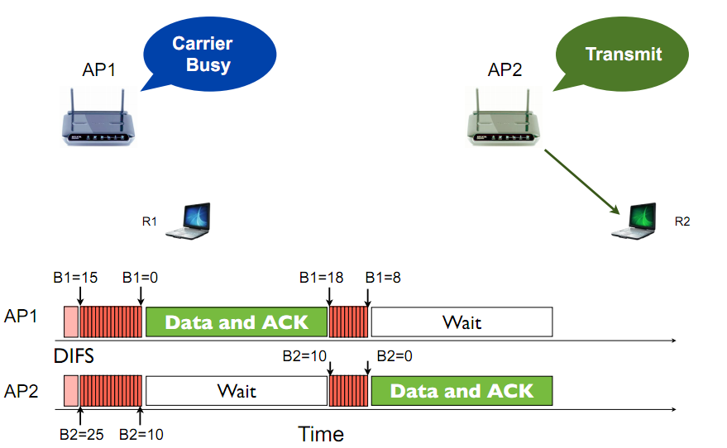
802.11 Backoff Example

Slide 35
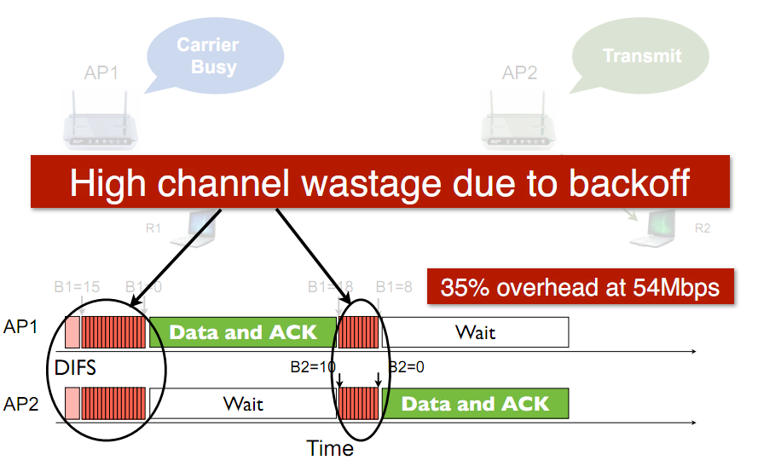
802.11 Backoff Example

Slide 36
Avoiding collisions (more)
idea: allow sender to “reserve” channel rather than random access of data frames: avoid collisions of long data frames
sender first transmits small request-to-send (RTS) packets to BS using CSMA
  RTSs may still collide with each other (but they’re short)
BS broadcasts clear-to-send CTS in response to RTS
CTS heard by all nodes
  sender transmits data frame
  other stations defer transmissions
avoid data frame collisions completely
using small reservation packets!

Slide 37
Collision Avoidance: RTS-CTS exchange
A
B
AP
RTS(B)
RTS(A)
reservation collision
RTS(A)
CTS(A)
CTS(A)
DATA (A)
defer
time
ACK(A)
ACK(A)

Slide 38
802.11 Overhead
DIFS
Random
Backoff
Data Transmission
Overhead:
  DIFS
  Random backoff
  ACK/SIFS
  Optional RTS/CTS handshake before transmission of data packet (often disabled due to its overhead)
  Header overhead
802.11 has room for improvement. How?
SIFS
ACK
Transmission

Slide 39
802.11 frame: addressing
2
2
6
6
6
2
6
0 - 2312
4
frame
control
duration
address
1
address
2
address
3
seq
control
address
4
payload
CRC
Address 4: used when a frame is sent from one AP to another AP
Address 1: MAC address
of wireless host or AP
to receive this frame
Address 3: MAC address
of router interface to which AP is attached
Address 2: MAC address
of wireless host or AP
transmitting this frame

Slide 40
802.11 Unicast vs. Broadcast
  802.11 unicast
802.11 Broadcast
RTS/CTS
ACK/Retx
Exponential backoff
Autorate adaptation
No RTS/CTS
No ACK/Retx
No exponential backoff
Single (low) rate

Slide 41
Wireless, mobility: impact on higher layer protocols
logically, impact should be minimal …
  best effort service model remains unchanged
  TCP and UDP can (and do) run over wireless, mobile
… but performance-wise:
  packet loss/delay due to bit-errors (discarded packets, delays for link-layer retransmissions), and handoff
  TCP interprets loss as congestion, will decrease congestion window un-necessarily
  delay impairments for real-time traffic
  limited bandwidth of wireless links

